Slide 1
This is the only way…

Slide 2
Purpose of a Safety Program?
Through controls, reduce the frequency and severity of incidents.
Effectiveness.
Get results.

Slide 3
Loss Improvement
Risk Improvement

Slide 4
Each safety rule matters… The only way to make a safety rule effective:
The written rules focused appropriately…
Followed by education and training on those rules…
Followed by auditing to verify / validate the rules are being followed…
Followed by documented corrective action / follow up / thank you…

Slide 5
When was the last time your written safety & work comp expectations were reviewed and signed?
When was the last safety meeting your employees attended?
Does anyone perform documented inspections / observations?
When was the last time corrective action occurred after an unsafe act / condition?

Slide 6
A
T
T
E
N
T
I
O
N
E
M
P
H
A
S
I
S
E
F
F
O
R
T
AS RISK GOES UP
EXPOSURE TO INJURY FROM WORK OR TASK HAZARDS

Slide 7
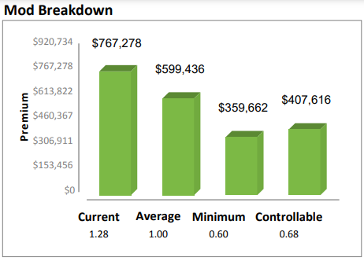

Slide 8
All safety activities must be focused through the prism of priority – focus on the right things that reduce fatality & injury risks, top citations.
Safety Activities
Accurized Safety Efforts
Top injury types & risks
Top fatality risks
Top citations
https://wonderopolis.org/wonder/What-Are-Prisms

Slide 9
Loss Prevention – What is a “Loss”
Properly administered plans reduce the frequency & severity of
Sudden traumatic incidents
Occupational disease
When an incident occurs, loss management controls
Direct Costs
Indirect Costs

Slide 10
29 USC 654 General Duty Clause Did you know OSHA wants employees to follow safety rules?
(a)Each employer
(1)shall furnish to each of his employees employment and a place of employment which are free from recognized hazards that are causing or are likely to cause death or serious physical harm to his employees;
(2)shall comply with occupational safety and health standards promulgated under this chapter.
(b)Each employee shall comply with occupational safety and health standards and all rules, regulations, and orders issued pursuant to this chapter which are applicable to his own actions and conduct.

Slide 11
OSHA Employee Misconduct Defense
Employee actions are always taken into account during all OSHA inspections, and employees and employee representatives are encouraged to participate.
Unsafe actions by employees are brought to the attention of the employer. In those situations where the employer has met all the conditions for affirmative defense, no citation is issued. The conditions for affirmative defense associated with "unpreventable employee misconduct" or "isolated event" are listed below. The violative conduct was:
unknown to the employer; and
in violation of an adequate work rule which was effectively communicated and uniformly enforced.
However, it is our experience that unsafe acts of employees are often known by management and that they are often allowed to proceed without remedial action. When it is found that employers have not been pro-active in controlling these conditions, citations are issued to the employer.

Slide 12
The State of Missouri supports safety!
Please Develop Safety Rules
Section 287.120.5
Where the injury is caused by the failure of the employee to use safety devices where provided by the employer, or from the employee's failure to obey any reasonable rule adopted by the employer for the safety of employees, the compensation and death benefit provided for herein shall be reduced at least twenty-five but not more than fifty percent; provided, that it is shown that the employee had actual knowledge of the rule so adopted by the employer; and provided, further, that the employer had, prior to the injury, made a reasonable effort to cause his or her employees to use the safety device or devices and to obey or follow the rule so adopted for the safety of the employees.
Initial Employee Orientation Training
Signed Receipt of Employee Manual, Ongoing Safety Meeting Logs
Specific Safety Training
Documented Corrective Action / Enforcement

Slide 13
The State of Missouri supports safety!
Please Develop a Drug & Alcohol Policy
Section 287.120.6
(1) Where the employee fails to obey any rule or policy adopted by the employer relating to a drug-free workplace or the use of alcohol or nonprescribed controlled drugs in the workplace, the compensation and death benefit provided for herein shall be reduced fifty percent if the injury was sustained in conjunction with the use of alcohol or nonprescribed controlled drugs.
(2) If, however, the use of alcohol or nonprescribed controlled drugs in violation of the employer's rule or policy is the proximate cause of the injury, then the benefits or compensation otherwise payable under this chapter for death or disability shall be forfeited.
(3) An employee's refusal to take a test for alcohol or a nonprescribed controlled substance, as defined by section 195.010, at the request of the employer shall result in the forfeiture of benefits under this chapter if the employer had sufficient cause to suspect use of alcohol or a nonprescribed controlled substance by the claimant or if the employer's policy clearly authorizes post-injury testing.

Slide 14
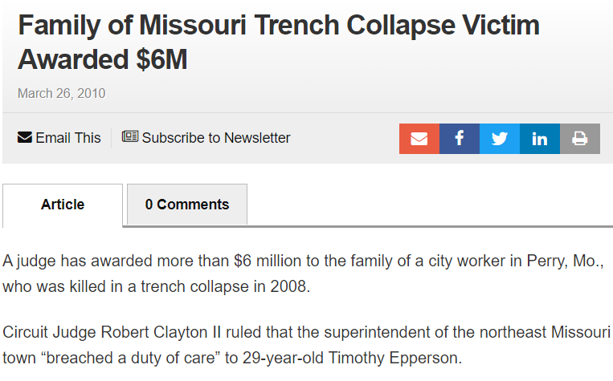
“breached a duty of care”

Slide 15
Hierarchy of Work-Related Deaths
Motor Vehicle Accidents
Falls
Workplace Violence
Electrocution
Struck By
Caught In Between

Slide 16
Hierarchy of Injuries
Slips, Trips, Falls
Overexertion
Motor Vehicle Accident
Hazardous Contact

Slide 17
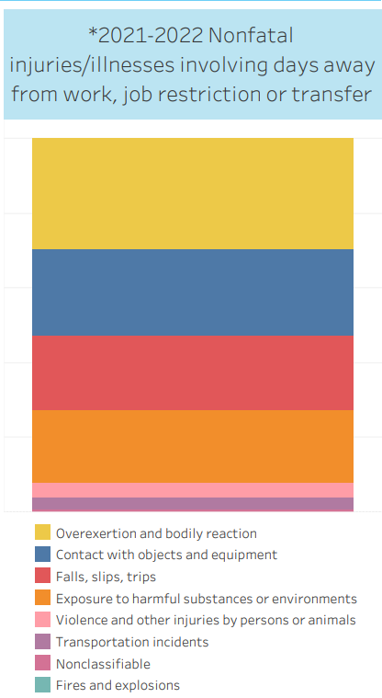
https://injuryfacts.nsc.org/work/work-overview/top-work-related-injury-causes/data-details/

Slide 18
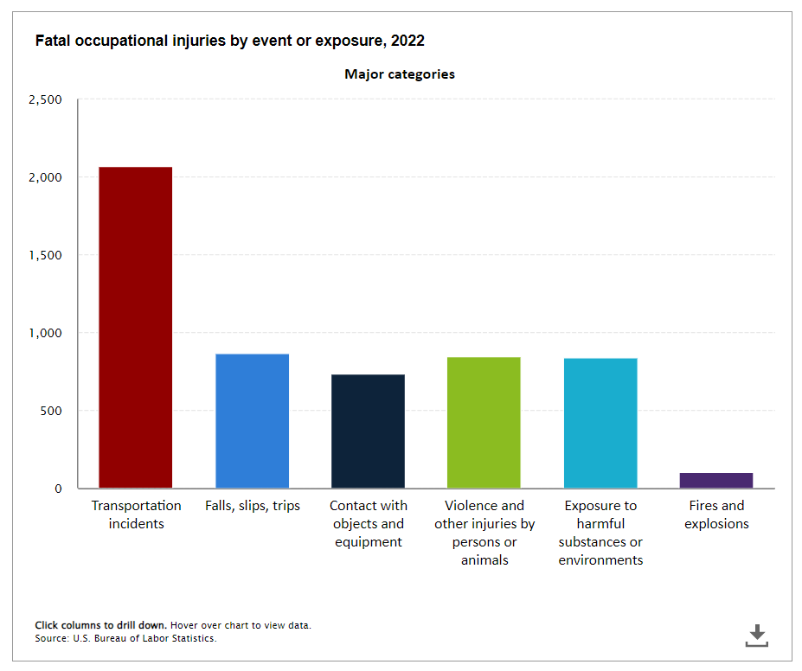
https://www.bls.gov/charts/census-of-fatal-occupational-injuries/fatal-occupational-injuries-by-event-drilldown.htm

Slide 19
“All-Employee" Safety Plan (personnel manual?)
All Employee Rules (Also for new hires)
Water Department
Police Department
Fire Department
Street Department
Written rules.
Documented knowledge.
Monitoring.
Written corrective action.
Written rules.
Documented knowledge.
Monitoring.
Written corrective action.
Written rules.
Documented knowledge.
Monitoring.
Written corrective action.
Written rules.
Documented knowledge.
Monitoring.
Written corrective action.
These activities should result in reduced FREQUENCY and SEVERITY of injuries AND reduced experience ratings.

Slide 20
“All-Employee" Safety Plan (personnel manual?)
All Employee Rules (Also for new hires)
Water Department
Police Department
Fire Department
Street Department
What things cause death?
Motor Vehicle Crash
Falls.
Workplace violence.
Electrocution.
What things cause injury?
Slips, Trips, Falls
Overexertion
Motor Vehicle Crash
Struck-By.
Task / Process
Tool / Equipment / Machine
Written rules.
Documented knowledge.
Monitoring.
Written corrective action.
These activities should result in reduced FREQUENCY and SEVERITY of injuries AND reduced experience ratings.

Slide 21
“All-Employee" Safety Plan (personnel manual?)
All Employee Rules (Also for new hires)
Water Department
Police Department
Fire Department
Street Department
What things cause death?
Motor Vehicle Crash
Falls.
Workplace violence.
Electrocution.
What things cause death?
Motor Vehicle Crash
Falls.
Workplace violence.
Electrocution.
What things cause death?
Motor Vehicle Crash
Falls.
Workplace violence.
Electrocution.
What things cause death?
Motor Vehicle Crash
Falls.
Workplace violence.
Electrocution.
What things cause injury?
Slips, Trips, Falls
Overexertion
Motor Vehicle Crash
Struck-By.
What things cause injury?
Slips, Trips, Falls
Overexertion
Motor Vehicle Crash
Struck-By.
What things cause injury?
Slips, Trips, Falls
Overexertion
Motor Vehicle Crash
Struck-By.
What things cause injury?
Slips, Trips, Falls
Overexertion
Motor Vehicle Crash
Struck-By.
Task / Process
Tool / Equipment / Machine
Task / Process
Tool / Equipment / Machine
Task / Process
Tool / Equipment / Machine
Task / Process
Tool / Equipment / Machine
Written rules.
Documented knowledge.
Monitoring.
Written corrective action.
Written rules.
Documented knowledge.
Monitoring.
Written corrective action.
Written rules.
Documented knowledge.
Monitoring.
Written corrective action.
Written rules.
Documented knowledge.
Monitoring.
Written corrective action.
These activities should result in reduced FREQUENCY and SEVERITY of injuries AND reduced experience ratings.

Slide 22
All Employee Policies, Procedures, Documents.
TOOL RULES
MACHINE RULES
WORK METHODS
EQUIPMENT RULES
CHEMICAL RULES
PROCESS RULES

Slide 23
All Employee Policies, Procedures, Documents.
Departmental policies, procedures, documents.
Warehouse, receiving, shipping, trucking, etc.
TOOL RULES
MACHINE RULES
WORK METHODS
EQUIPMENT RULES
CHEMICAL RULES
PROCESS RULES

Slide 24
All Employee Policies, Procedures, Documents.
Departmental policies, procedures, documents.
Water, sewer, parks, fire, streets, electric, PD.
OWNER’s MANUALS, SDS, CONTAINER LABELS, WARNING LABELS, ENGINEERING DIAGRAMS
TOOL RULES
MACHINE RULES
WORK METHODS
EQUIPMENT RULES
CHEMICAL RULES
PROCESS RULES

Slide 25
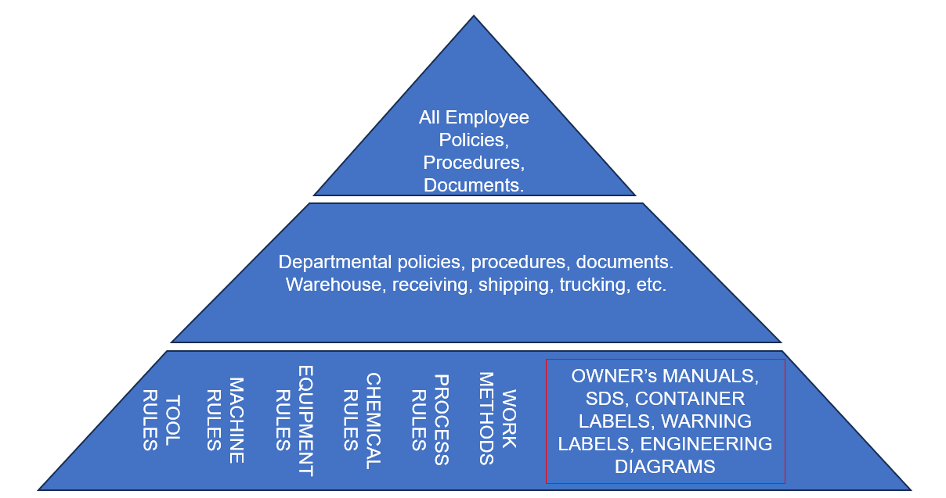
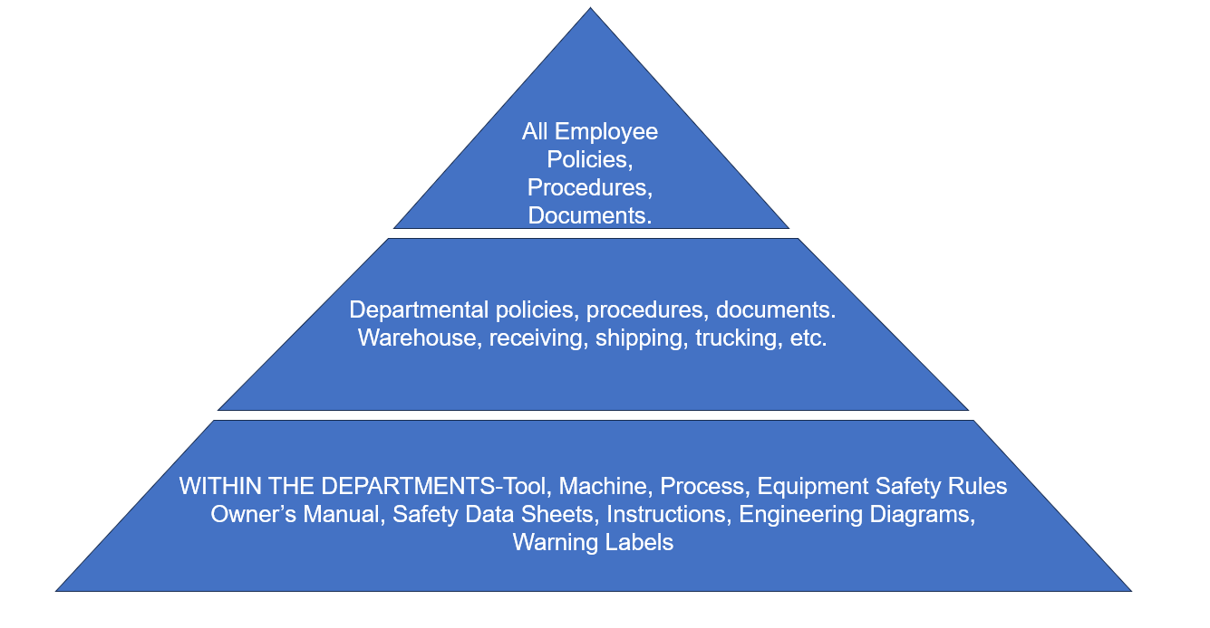
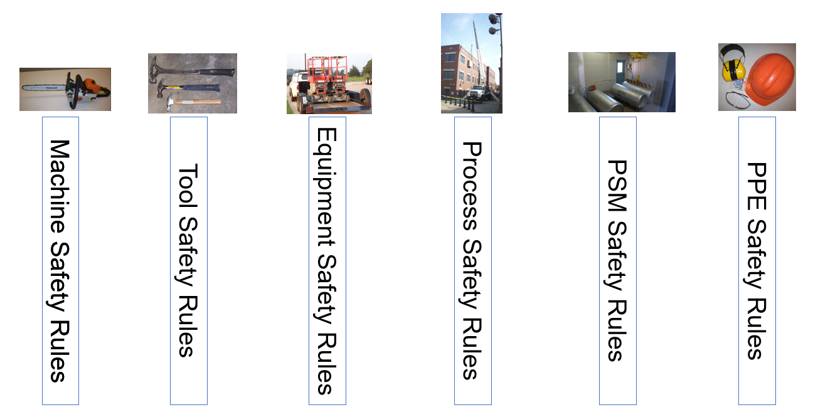

Slide 26
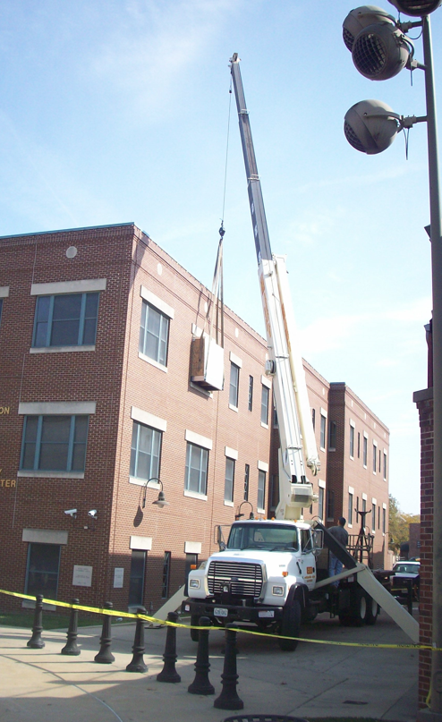
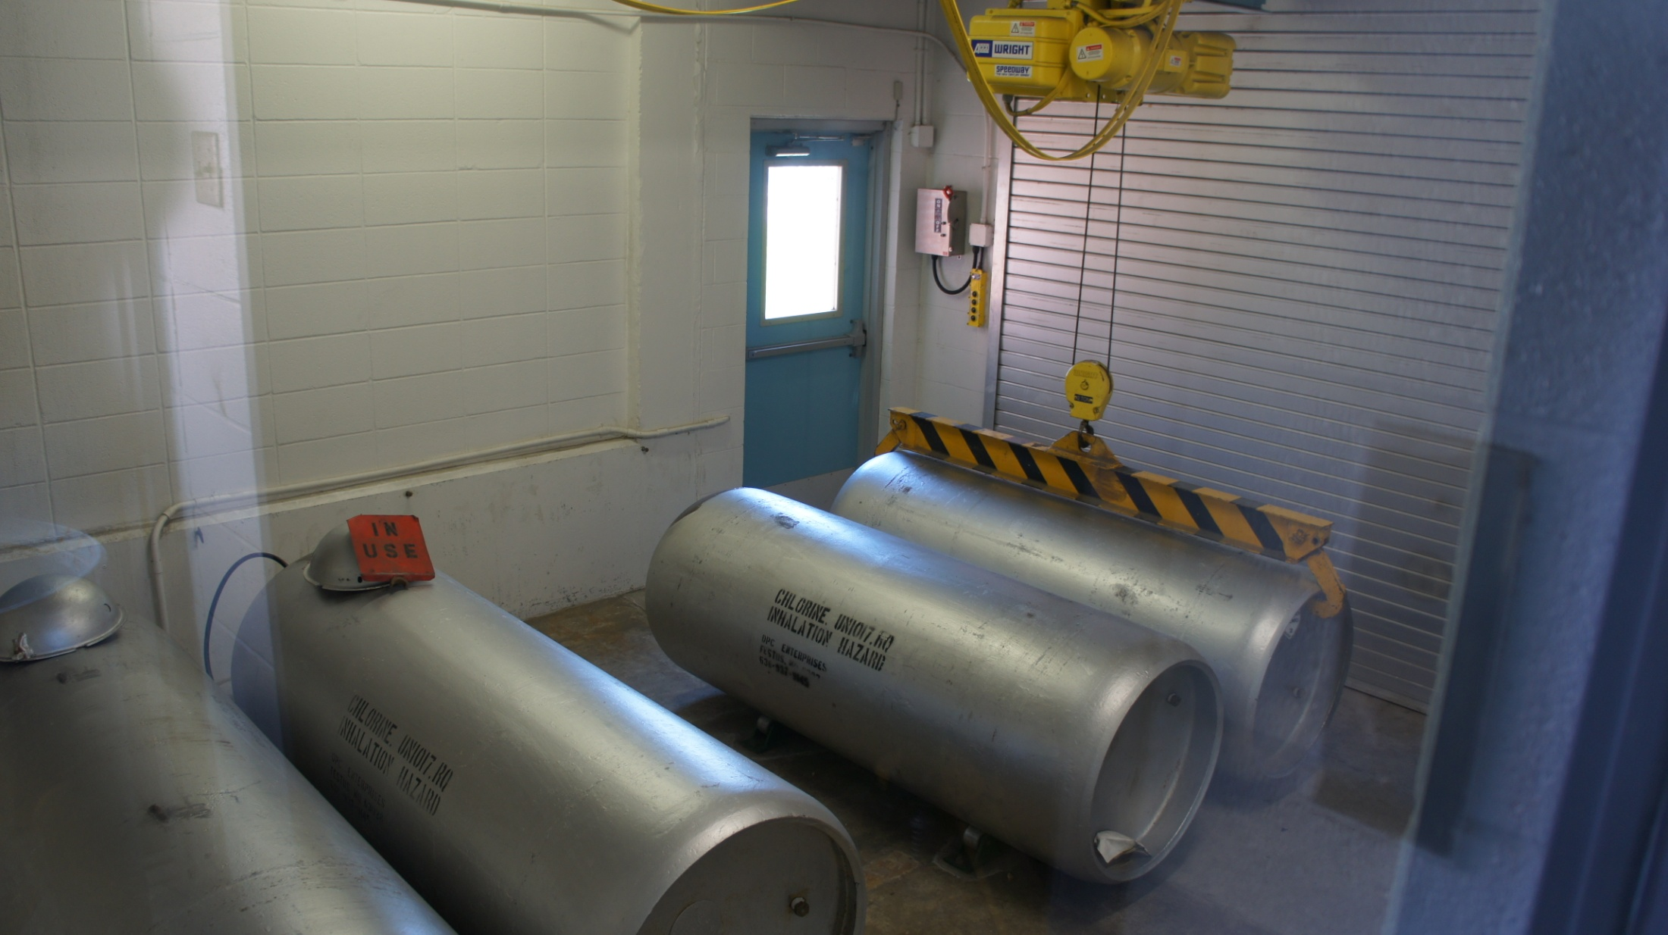
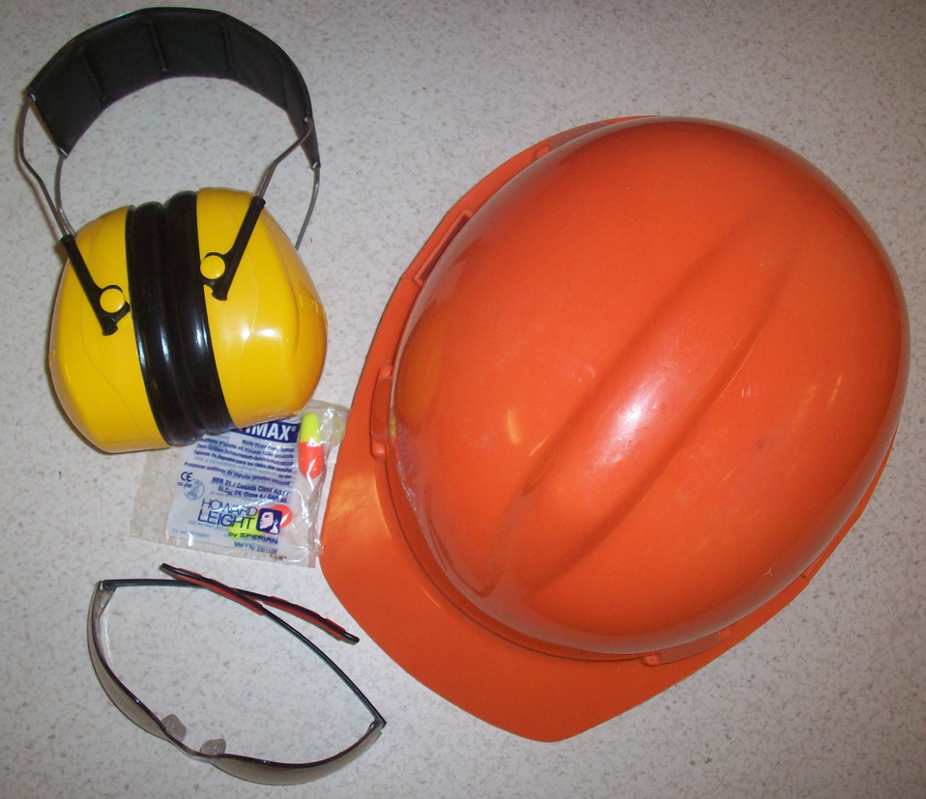
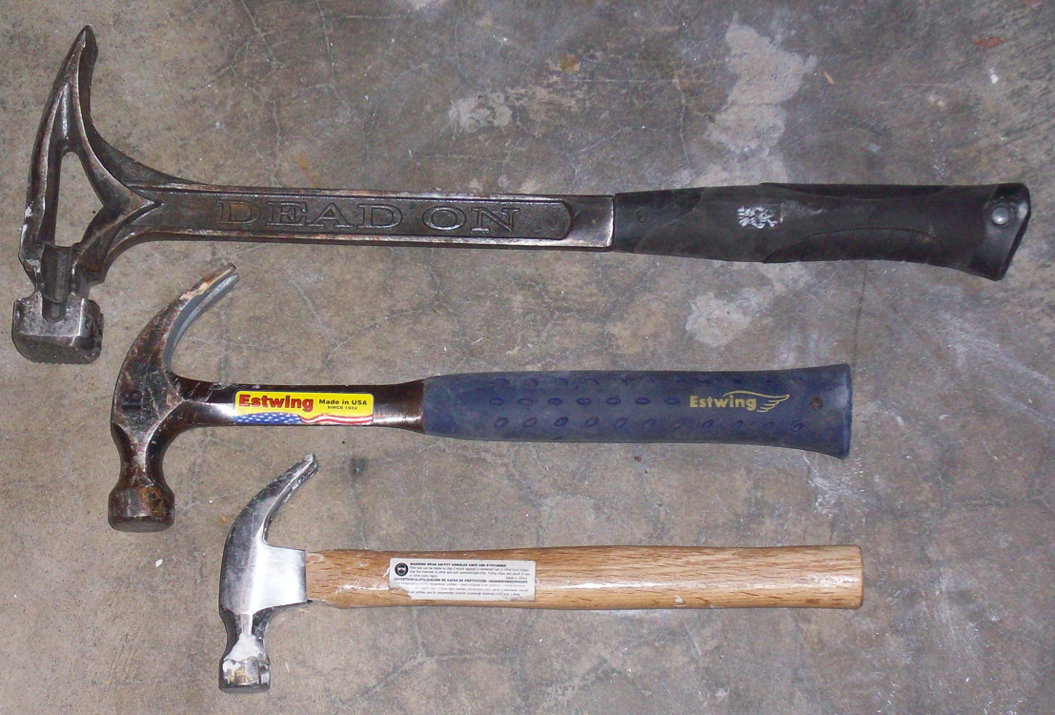
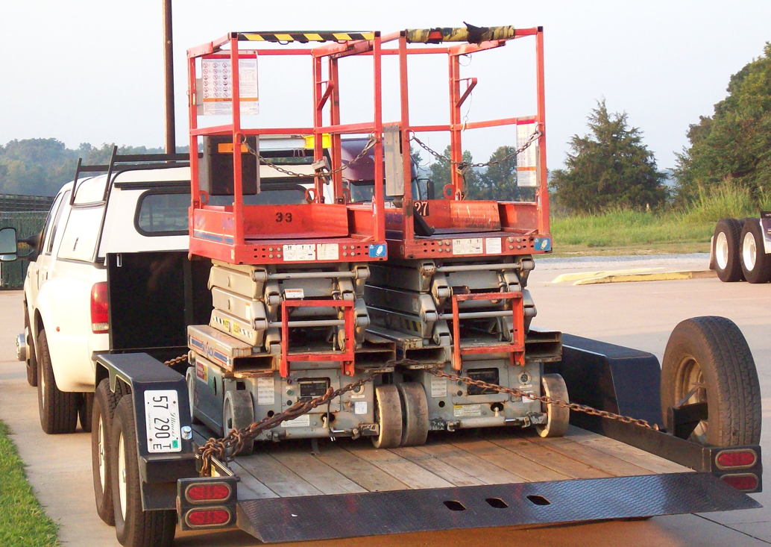
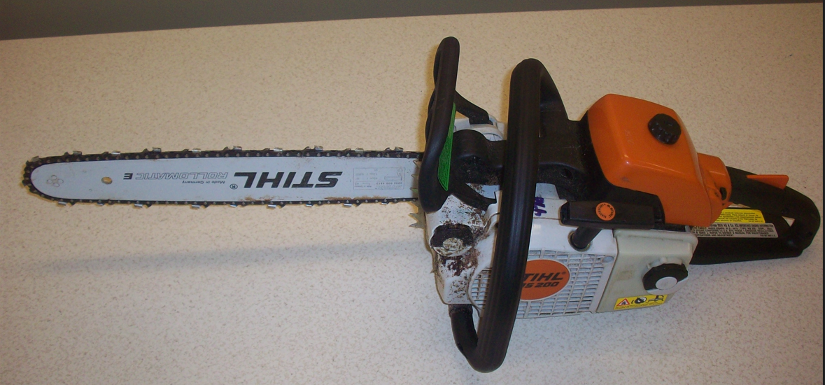
Equipment Safety Rules
Process Safety Rules
PSM Safety Rules
Machine Safety Rules
PPE Safety Rules
Tool Safety Rules
Machine Safety Rules

Slide 27
TOP-DOWN
WORST FIRST
Equipment Safety Rules
Process Safety Rules
PSM Safety Rules
Machine Safety Rules
PPE Safety Rules
Tool Safety Rules
Machine Safety Rules

Slide 28
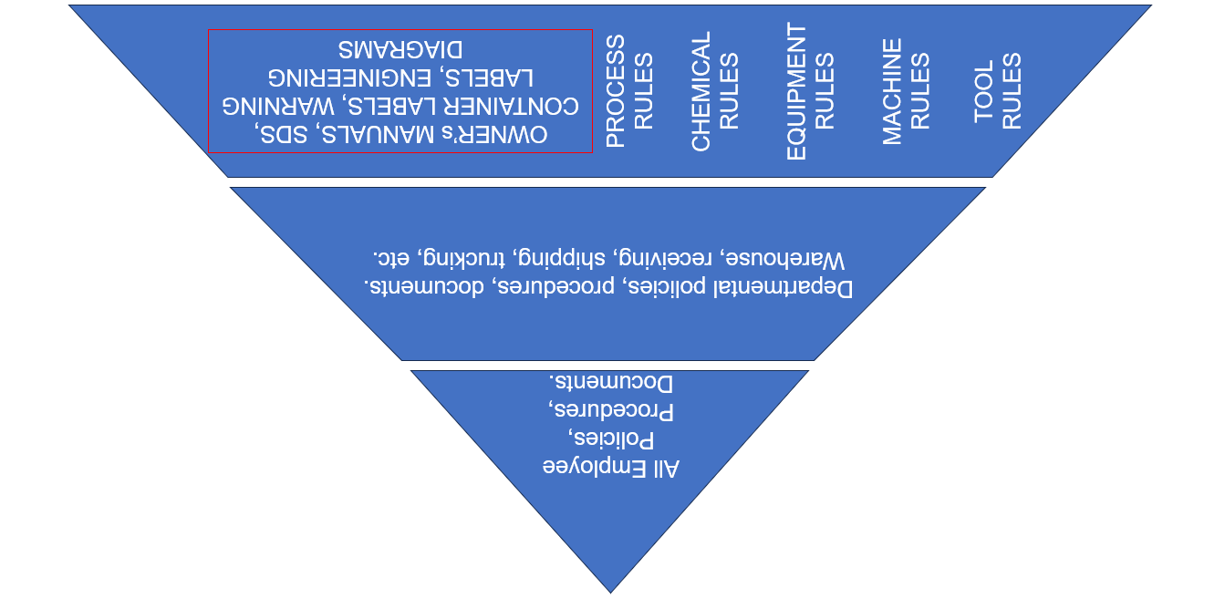
REDUCED FREQUENCY AND SEVERITY OF INCIDENTS
ASSOCIATED COST SAVINGS

Slide 29
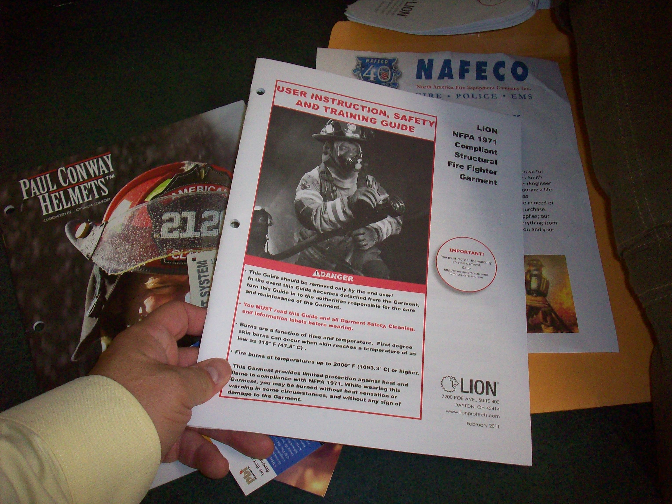
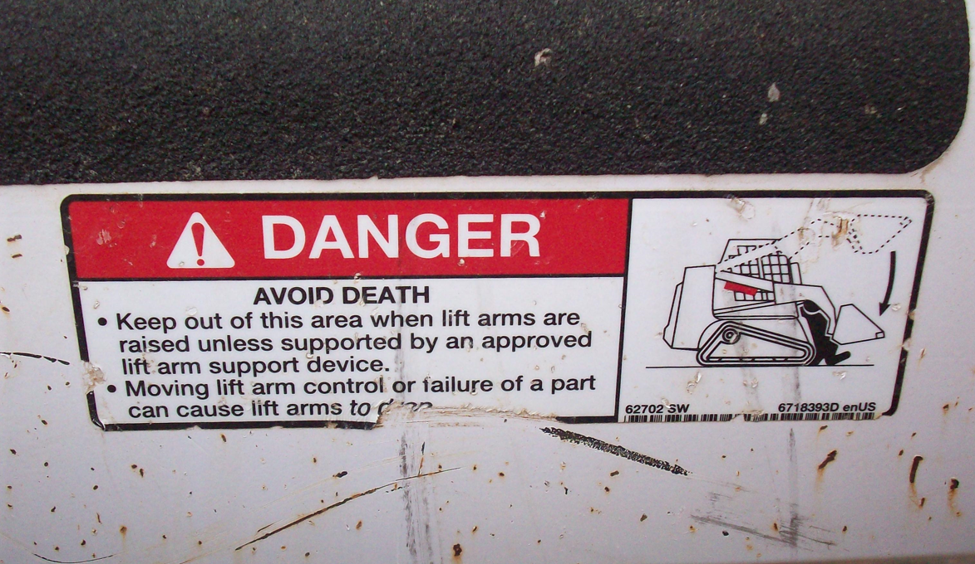

Slide 30
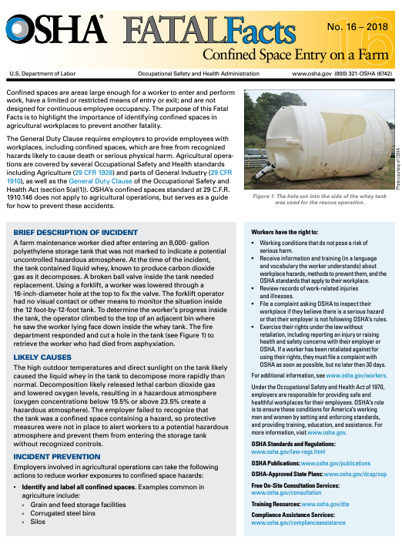
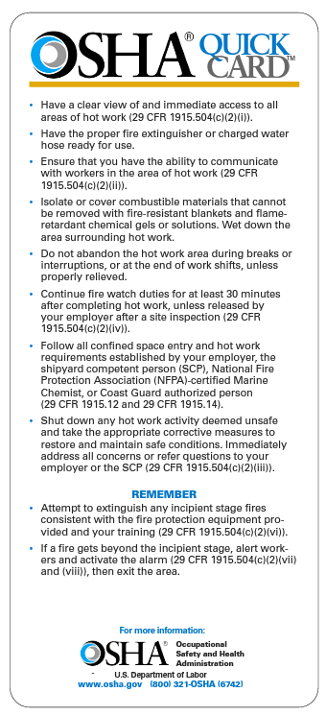

Slide 31
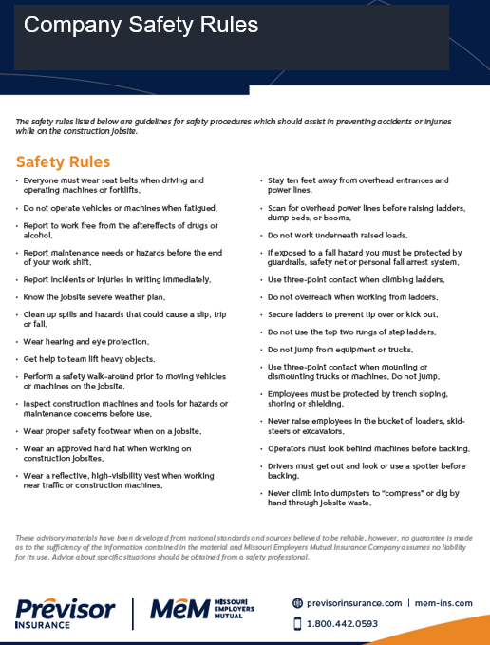
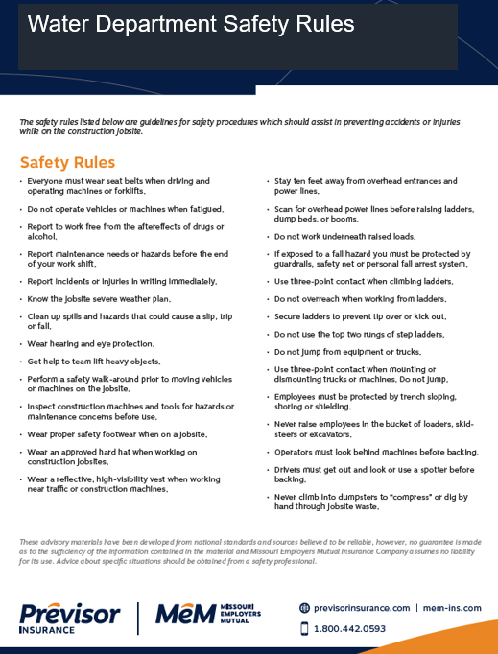
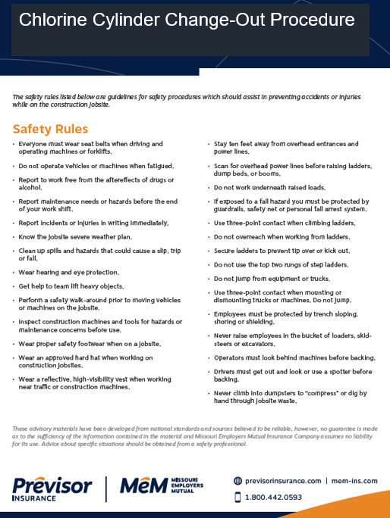
OVERALL ALL-EMPLOYEE SAFETY PLAN
SAFETY RULES FOR MAJOR JOBS, TASKS, DUTIES
MACHINE, TOOL OR JOB-SPECIFC RULES

Slide 32
Safety rules are specific expectations.
Safety rules are statements direct in nature like:
“Wear your seat belt when driving or riding in any vehicle used for work-related purposes.”
Or
“Use the provided push stick to feed lumber through table saw no. 6.”

Slide 33
Safety rules are NOT generalizations, or vague non-specific, or unachievable statements like:
“Lift safely”
Or
“Drive safely”
Or
“Follow all OSHA standards”
Or
“Follow the law”

Slide 34
OVERALL CITY SAFETY PLAN
Seat Belt Policy
Drug-Free Workplaces Policy
Injury / Incident Reporting Procedure
Safe Driving Rules
These all apply to:
Police
Fire
Public Works
Electric
Water-Wastewater
Parks
Cemetery
Airport

Slide 35
SAFETY RULES FOR MAJOR JOBS, PROCESS, TASKS, DUTIES

Slide 36
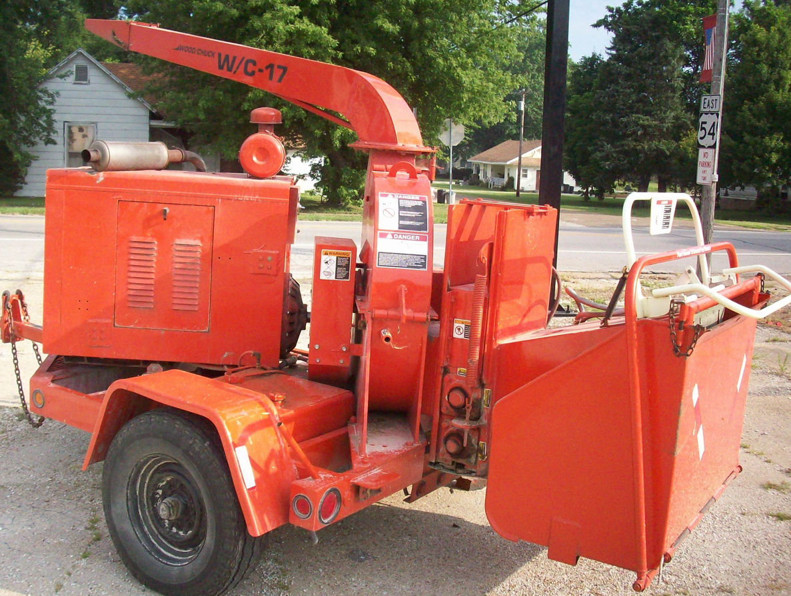
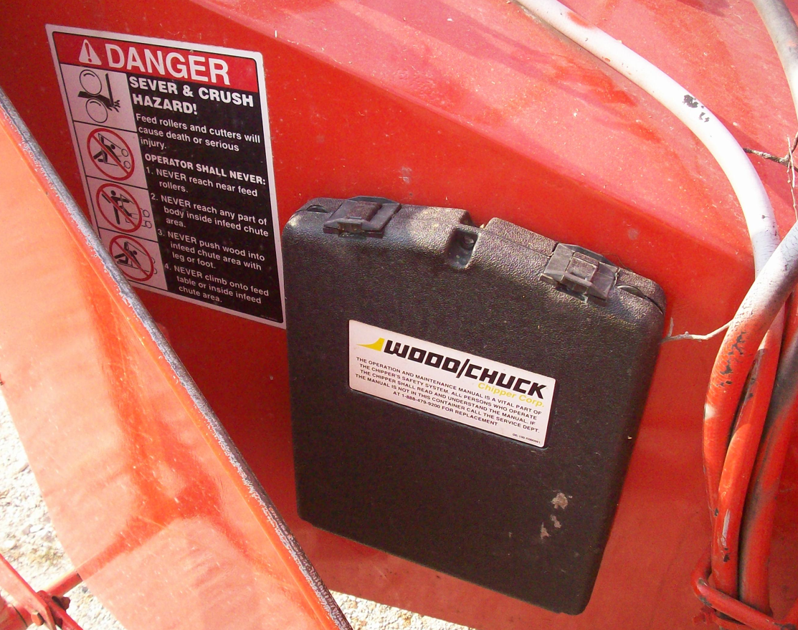
MACHINE, TOOL OR JOB-SPECIFC RULES

Slide 37
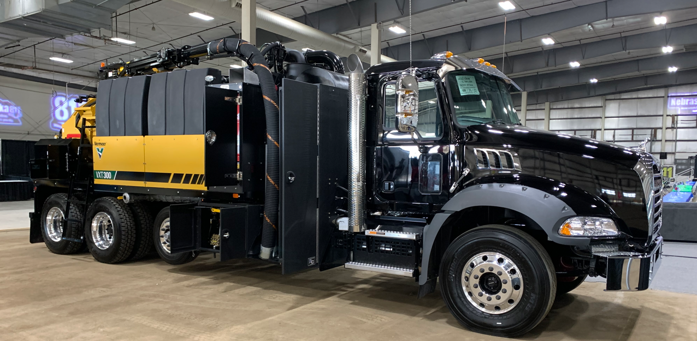
SAFE DRIVING SAFETY RULES
MACHINE OPERATIONS SAFETY RULES
CHASSIS SAFETY RULES

Slide 38
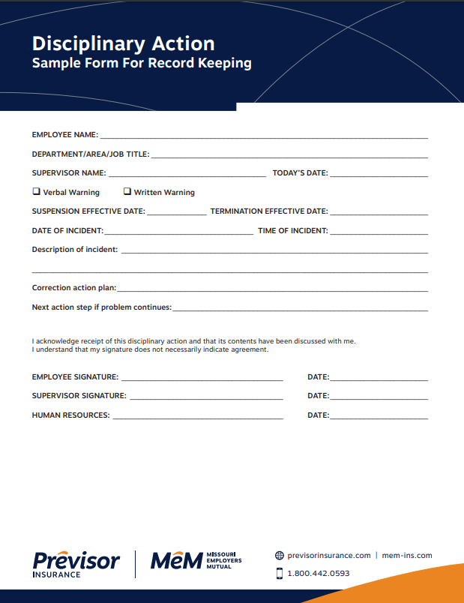
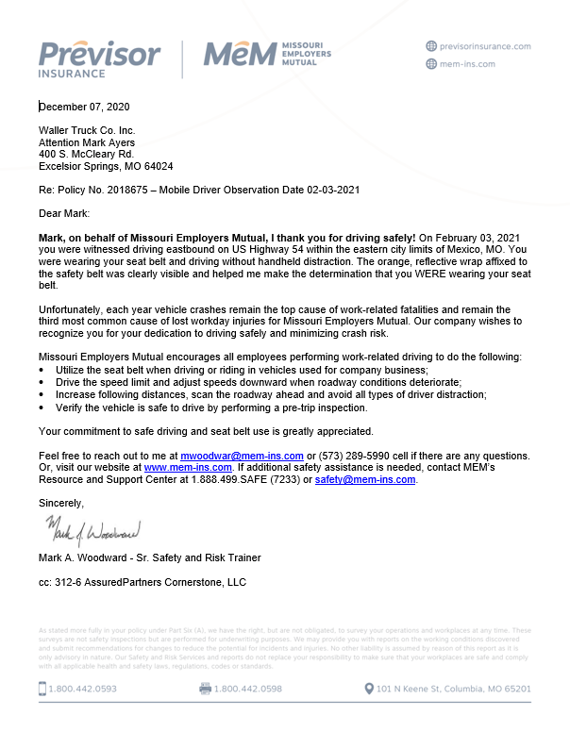
Inspections PROVE if the safety plan is working.
Document Self-Inspection Findings.
Document corrective action,
ALWAYS document when no corrective action is needed.
Employee recognition is a MUST.
Publish all findings.
Assign a $$$ value.

Slide 39
SAFETY MUST-HAVES
ALL Management Commitment (Top and Middle Mgmt.)
Understand Your Costs – EMR, Premium, Claims
Develop, Communicate, Enforce Focused Safety Rules
Hold Regular Safety Education & Provide Training
Perform Documented Corrective Action
Inspect Jobsites, Tools, Machines, Premises, and Vehicles
Enforce a Drug-Free Workplace (NH & PA)
Enforce a Written Seat Belt Policy – All Employees
Enforce Written Distracted Work / Driving Policy
New Hires – Provide Training and Set Expectations
New Hires – Post-Offer Employment Physicals

Slide 40
That’s it!
Thank you!!!
Mark Woodward, Sr. Safety and Risk Trainer

